Slide 1
Ch. 7: Banking Services
7.1 How Banks Work
7.2 Use Your Checking Account
7.3 Balance Your Checkbook
7.4 Electronic Banking Services
7.5 Other Banking Services

Slide 2
7.1 How Banks Work
The Role of Banks
Banks are in business to earn a profit
Make money off interest ___________ on loans
Money lent comes from deposits made by consumers & ______________
You deposit $100 & get 2% interest, bank lends your $100 & charges 6% interest. The bank gains 4% of the interest earned off of loan
Other sources of income
Fees for credit cards &
Create customer financial plans for _________
Bank Provide Security
Protect Your Money’s Purchasing ____________________
Example: Save $150 dollars for a year for a Mp3 player.
In bank = after 1 year, have $157.50
At home = have $150
Mp3 player price goes up to $153.00 due to inflation
If saved in bank, you have $________ left over
If saved at home, have to add $3.00.
Banks Are Regulated
More government rules and regulations for _______________
If banks lose money, must lose their profit first before affecting customer
Must set aside money part of __________________
Deposits are insured up to $250,000 by the FDIC(Federal Deposit Insurance Corporation)

Slide 3
7.1 How Banks Work
Banks Make Borrowing Easier
Banks help money flow from savers to ___________________
Banks evaluate borrowers by buying financial ________________ about them to decide whether to take the risk
Banks help people pay for houses, cars, ___________, roads, etc…
Money and Financial Transactions
If money didn’t exist, you would _________________
Bartering can get confusing and unfair.
Money allows you to compare value of one ________ to value with another
You can get products you want without trading something of ____________ value.
Types of Money
Currency
-
Checks
-
Advantages of using checks
Safety -
Convenience -
Records of Your Transactions
-

Slide 4
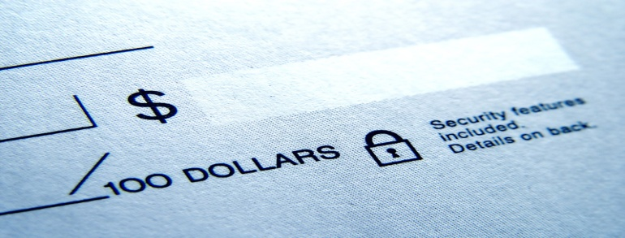
7.2 Use Your Checking Account
Your Checking Account
Open a _________ Account
Under 18, open _____________account with parent
Will have to sign signature card for bank to keep on file to check for signature _____
Write a check
The date you filled out check
Name of payee
Amount of check
Signature
Record Checks in Register
Record Each Transaction
Record Fees
Record Interest
Calculate New Balance
Record Check Numbers
Overdrawing means ____________________________________________________

Slide 5
7.2 Use Your Checking Account
Cash Checks or Transfer Them to Someone Else
Cash a Check
Take to bank
Endorse on _________________
Can cash check by writing check to __________________________
Make sure you give ID and sign back of check
Transfer a Check
If want to sign check in your name over to ______________, write pay to order of that person on back of check
Sign name below
Deposits
Deposit Form
Found at back of checkbook or at bank
Parts of Form
Checks
Currency
Less Cash Received
For Deposit Only
If want to deposit whole check, endorse by writing for deposit only & signature
Record Your Deposit
The Check Clearing Process
When depositing, cannot withdrawal __________________
Check must clear first
Bank has to wait for payment from writer’s account
Can process overnight with __________________ or up to week if written far away

Slide 6
7.2 Use Your Checking Account
Checking Account Types and Costs
Checking Account Types
Interest ________________
Banks lend part of money deposited and receive interest
You receive __________ from bank
Usually have to keep _____________ sum in at all times
Fee might be charged if drop under minimum
Nonintererst-Bearing Checking Accounts
For __________ amounts in account
Bank earns income by using your funds and paying no _____________
Checking Account Fees
Three types of fees
Monthly _______________
Flat fee to cover costs of maintaining account
Charge Per Check
.15 to .25 per _______
Overdrawing Your Account
Assignment: p. 231, #1-6

Slide 7
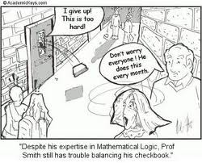
7.3 Balance Your Checkbook
Your Bank Statement
Your Bank Statement
Receive each month for ________________ month
Time for comparing statement to register is called _________________
The Account Reconciliation Form
Statement column
Balance from __________________
List deposits not on statement
___________ statement balance
List checks not on statement
Total checks
Statement balance

Slide 8
7.3 Balance Your Checkbook
Checkbook Column
Balance from Checkbook
List ____________ not in checkbook
Total checkbook balance and deposits
List ___________ not in checkbook
Enter interest payment
Total fees and __________________
Checkbook balance
Make Adjustments
Check register _________ needs to match that on reconciliation form
What If the Bank Made an _____________?
Go to filing system and get deposit ___________
Take to bank and explain problem to teller
If agreed, then they will ______________________

Slide 9
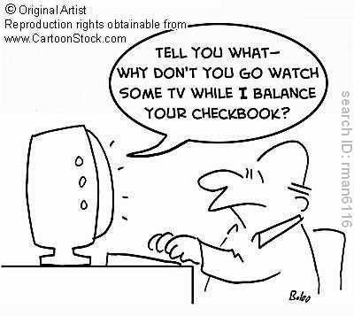
7.3 Balance Your Checkbook
File Your Records
Keep deposit receipts, statements, and _____________________
If ever a question of what you have done, have _______________
Keep images of all cancelled checks in case dispute over a ________________ made with check
Assignment: p. 237,
#1-4

Slide 10
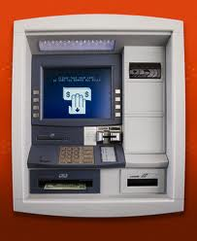
7.4 Electronic Banking
Electronic Funds Transfer and ATMs
EFT’s – banks allow consumers to move money from one account to another by _____________________
Automated Teller Machines (ATM’s)
Your ATM Card and ____________
Can be used at any time, day or night
Must have bank issued card
Card has ____________ strip and sometimes embedded chip to identify you
Must have PIN(Personal Identification Number) # to use _______________
ATM Deposits
Place endorsed check into special _______________________
Will need to put personal info on envelope with ink
Insert card and follow directions on ______________
Always record in your register
ATM Withdrawals
To withdraw, follow instructions on screen
ATM’s only disperse paper money $20’s & $10’s
Keep ____________________
ATM Costs
Charged __________ if not your banks ATM’s
Can cost up to $4.00 per transaction
Sometimes if small deposit, can be charged a fee using tellers, because want to encourage using ________________
Banks have reduced number of tellers employed by almost 40% because of ATM’s

Slide 11
7.4 Electronic Banking
Use ATM’s Responsibly
People can steal with card and pin number
Be sure nobody sees you put in pin _____________
Do not write pin # on card
Do Not give to someone to use
If lose, report _____________________
Will be issued new card
Reduce risk by using with friend and during ______
If afraid to carry cash in area, do not use the ATM
Use of Electronic Funds Transfer
Can use direct deposit, debit cards, automatic payment, and online _______________
Direct Deposit
Paycheck is directly deposited
Will receive stub in mail or on business website
____________ uses to deposit tax returns

Slide 12
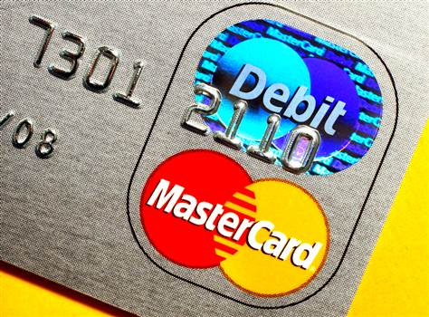
7.4 Electronic Banking
Debit Cards
AKA Check cards
Can be used as ATM cards or for _______________________
Card sends message to bank to check to see if money available
Bank sends electronic confirmation
Business prints ____________ for your purchase
Check card advantages:
Don’t have to carry and write checks
Will not be able to spend more than you _________________
Purchase paid ___________________
Make sure not being charged fee for using
Automatic Bill Payments
Pay by ____________
Money banks offer system for paying recurring bills by phone (water, phone, etc..)
First inform bank you wish to pay by phone
Might be charged a fee, but usually _________________
Procedures for setting up vary by banks
Once set up, dial number given and complete ______________________
Automatic Withdrawals
Arrange with bank to automatically pay bills from account
Example: house payment, phone bill, utilities, etc…
Must set up ____________ with bank
Will sign agreement to allow this
Will withdraw same day every month
Remember to write in check register
Do not get ____________, don’t forget!
Online Banking
Banks offer websites to complete transactions online
Must register with bank
Can add people to pay ______________

Slide 13
7.4 Electronic Banking
Consumer Protection and Responsibilities
1978 – Congress passed Electronic Fund __________ Act to protect consumers who make electronic transactions
Law requires consumers to use EFT’s _________________
Must report debit card loss within two days
If you notice missing money, for example $1000.00, call bank and you are only _____________for $50
If don’t report loss between 3 & 60 days, responsible for $500
Don’t report after 60 days, _________________ for all
Assignment: p. 245, #1-8

Slide 14
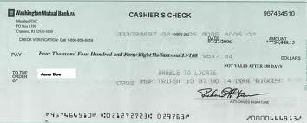
7.5 Other Banking Services
Different Checks for Different _____________
Certified Checks
Used for large purchases when business won’t accept __________________ checks
A check stamped & signed by bank officer
Stamp and ________________ guarantees that account has money to cover check
Is written to specific person
Must pay fee ranging from $5 to $20
Bank withdraws this money from your _________________
Cashier’s Checks
A check from the bank that the ___________ signs
Payment comes from the bank
Get cashiers check to guarantee _________________

Slide 15
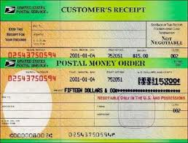
7.5 Other Banking Services
Money Order’s
Use if you don’t have a ________________ account
Use if small payment to business that doesn’t accept personal checks
Money Order- _____________
___________________________
___________________________
___________________________
Like cashiers check except:
Can be bought multiple places, not just banks
Your name appears on money __________________
Pay for up front
Charge a fee of $1 to $____
Can buy from bank, post office, check cashing business, ________________, American Express
made out to you and only the _____________ can cash it
With money orders, the payee knows that the check is “_____________”

Slide 16
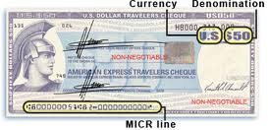
7.5 Other Banking Services
Traveler’s Checks
Check’s that you pay for in ________________
If lost or stolen, can be replaced by company that you bought them from
Can buy them from banks, __________ agencies, and AAA
Sold in amounts of $20, $50, or $100
Fee usually ______ percent of amount bought
To spend, must sign in front of person you are paying
Usually need ________.
Businesses willing to use these because payment is ______________________
Make sure you record in given register when you use one
Signature Line #1 – ___________________
______________________________________
Signature Line #2 – ________________
___________________________________

Slide 17
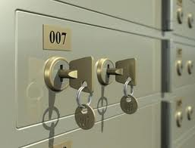
7.5 Other Banking Services
Other Services
_________________Transfers
Electronic communication that moves money from an account in one bank to _____________________
Happens _____________________
Large companies that need to pay millions to another company.
This means that they will not lose interest due to slow process of going through ____________________
Also used in _________________ if car breaks down.
Call bank to have money deposited into account of business fixing car
Usually charged a fee between $20 - $40
Usually go through bank but can use _________________ or Western Union
Amer. Exp. & Western Union not as convenient
Have to find location to pay money to and get wired to other __________
Safe Deposit _________________
Are boxes with individual locks that you can rent from a bank
Located in a ____________________
Safe from fire, theft, and loss
Cost is anywhere between $30 & $50 per year
Have different _____________________
When you rent, must have:
___________________
Paid a fee
Received a key
Every time you want to get into box, bring id and give key to ___________________________
They will compare your signature to card
Protects from someone else getting in __________________
Bank also has a key that bank representative must use with your key to get into.
Assignment: p. 251, #1-6

